Slide 1
TMI -101: Tinkering Part
Tinkering Project Title: Fingerprint Sensing
Team Members:
Aryan Singh- 23410008
Megha Agrawal - 23324011
Monika Choudhary -23112064
Shruti - 23411036
Faculty Supervisor/Advisor:
Prof. Ekant Sharma(ECE)
Prof. Mennakshi Rawat(ECE)
Project Implemented at:
STC-SDS Labs:

Slide 2
Understanding of the Problem
For the course TMI -101 we were assigned a project on Fingerprint sensing. The fingerprint sensor is one kind of sensor which is used in a fingerprint detection device.The main features of this device mainly include accuracy, better performance, robustness based on exclusive fingerprint biometric technology.Fingerprint scanners can be used in one of two ways, for verification or identification.In this modern era, it is increasingly difficult to secure physical location and digital data. Biometric data is gradually becoming a key that cannot be lost or a password that cannot be copied. Biometric technologies such as facial recognition and retinal patterns are good tools, but fingerprint recognition is the most common tool. So we decided to make a biometric attendance system based on fingerprint sensing.Biometric Attendance system has a wide application in schools, colleges, business organizations, and offices where marking of attendance is required accurately with time.

Slide 3
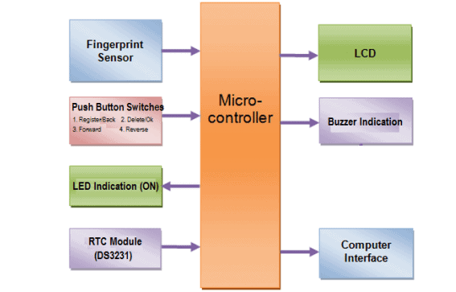
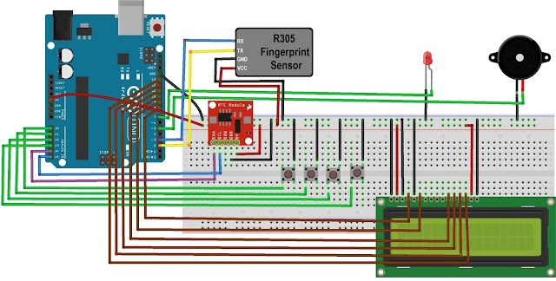
Understanding of the Problem
Fingerprint Sensor: This module scans and captures the unique fingerprint patterns of individuals. It then converts the fingerprints into digital data for further processing.
Display Module: An LCD display is utilized to provide real-time feedback, such as attendance status or instructions to users.
Keypad: A small keypad can be integrated to offer additional functionality, like an admin login or manual entry mode.
Buzzer: A simple audio output device, such as a buzzer, can be incorporated to provide auditory cues during various events, like successful authentication or errors.

Slide 4
Methodology/Approach Adopted for Project
In this project, we will design a Fingerprint Sensor Based Biometric Attendance System using Arduino.
We will be interfacing fingerprint sensor with Arduino, LCD Display & RTC Module to design the desired project.
We will use the fingerprint Module and Arduino to take and keep attendance data and records.
The Fingerprint Sensor module authenticates a true person or employee by taking their finger input in the system. Here we are using 4 push buttons to register a new fingerprint or delete a stored fingerprint or match a stored fingerprint.
The 4 push buttons are used as an input unit for these tasks.
Similarly, RTC Module DS3231 is used for registering scanning/entering/existing time of the user.
The LCD displays the time record and every function happening via the push button.
The buzzer indicates different functions and happening whenever an interrupt is detected. The LED is used for power indication.

Slide 5
The system administrator enrolls individuals by capturing their fingerprints using the fingerprint sensor. The unique fingerprint data is then stored in the Arduino's memory along with their corresponding identities.
Enrollment
Authentication
The Arduino compares the captured fingerprint data with the stored templates using an advanced matching algorithm. If a match is found, the individual's identity is verified.
When a person needs to mark their attendance, they place their finger on the fingerprint sensor. The sensor captures the fingerprint and converts it into digital data.
Matching Algorithm
Once the identity is verified , the system marks the attendance in real time, the LCD display may show a success message or persons name.
Attendance Marking

Slide 6
Summary of Current Progress
We have completed our research related to the project and the materials required.
The product list has been sent to STC.

Slide 7
THANK YOU

